Slide 1
Gujarat Vidyapith Chatbot
Falguni Maththar – 240160510026
Akshit Sonani - 240160510049

Slide 2
Agenda
Introduction
Key Features of Chatbot
Technology Stack
Project Architecture
Database Schema
Ui Design

Slide 3
Introduction
Why Chatbot?
This project aims to create an efficient and user-friendly chatbot system for Gujarat Vidyapith.
The system helps students, staff and visitors get quick answers to common queries related to the university.
It reduces manual workload and improves information accessibility.
The chatbot uses predefined intents, processes user questions and returns accurate responses.
The goal is to provide a simple, fast and reliable digital helpdesk.
What Problem Does It Solve?
Slow information delivery
Repeated manual queries to staff
Difficulty finding accurate and updated details
Confusion during admissions and department-level inquiries
Lack of a single point of information for the university

Slide 4
Key Features of Gujarat Vidyapith Chatbot
Provides instant answers to university-related queries
Covers departments, courses, admissions and general campus information
Works on intent-based training to maintain accuracy
Simple and clean chat interface for students and visitors
Centralized admin panel to add, update or remove intents
Responds 24/7 without depending on staff availability
Reduces repetitive workload for faculty and office staff
Supports structured responses for important topics like fees, programs and eligibility
Can be expanded with automatic model training in future
Lightweight design that works on the web without heavy setup

Slide 5
User Module – Features
User Registration
New users can create an account using basic details like name, email and password.
Secure Login
Only registered users can log in with valid credentials to access the chatbot.
Profile Handling
Users can view and update their profile details (name, contact info, etc.) to keep data accurate.
Chat with Chatbot
Logged-in users can ask queries related to Gujarat Vidyapith and get instant responses.
Chat History
Each user's previous conversations are stored so they can review past answers anytime.

Slide 6
Admin Module – Features
Admin Dashboard
Central panel showing overview of total users, active users, total chats and recent activity.
User Status Monitoring
Admin can see which users are active, inactive or newly registered.
View User Chat History
Admin can access user chat logs to:
  Analyze common queries
  Improve intents and responses
  Monitor misuse or inappropriate queries
System Control
Admin can manage intents, update responses and maintain the overall quality of the chatbot.

Slide 7
Technology Stack
Frontend
HTML
CSS
JavaScript
Bootstrap (for responsive UI)
Backend
Python
Django Framework
Chatbot core logic using NLTK / trained intent model
Database
SQLite (or the one you used)
Stores users, chat history, intents and admin data
Machine Learning / NLP
NLTK for text preprocessing
Bag-of-Words model
Custom trained model using json dataset
Tools & Libraries
Django Admin Panel
NumPy
Pickle for model storage
JSON for intents dataset
GitHub for version control
Environment
VS Code
Python Virtual Environment
Browser for deployment testing

Slide 8
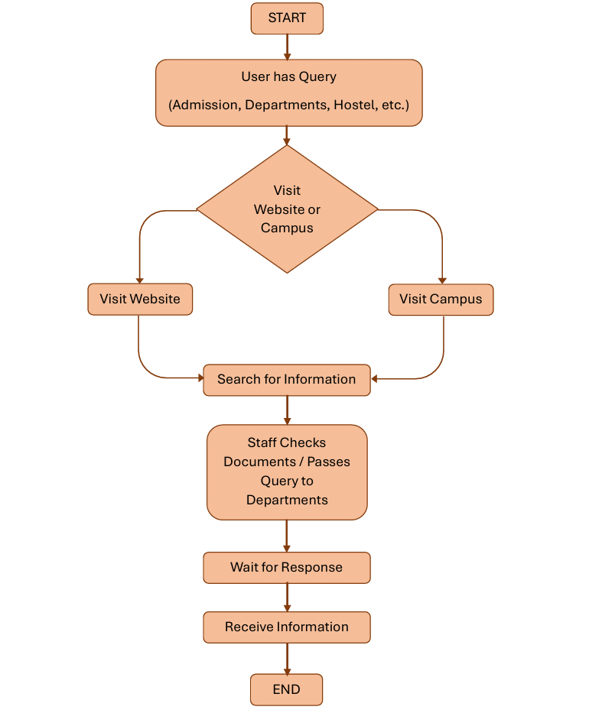
System Flow Chart
(Existing System)

Slide 9
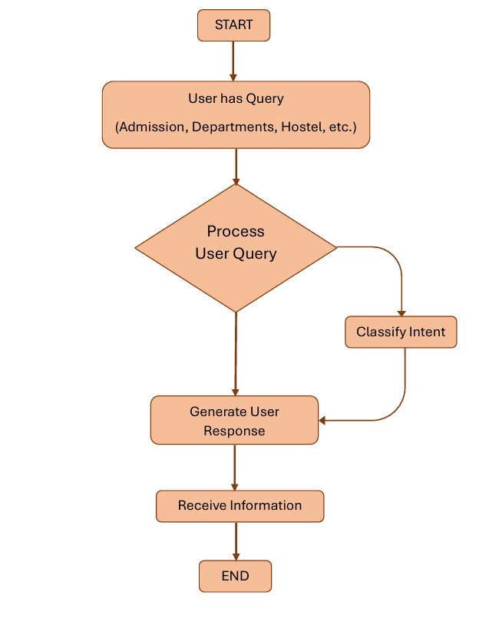
System Flow Chart
(Chatbot System)

Slide 10
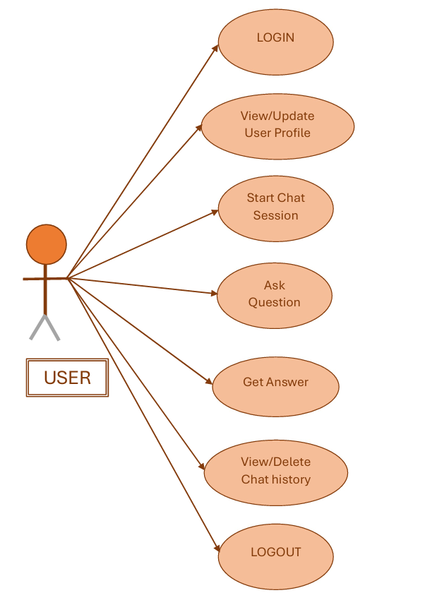
Use Case Diagram
(User)

Slide 11
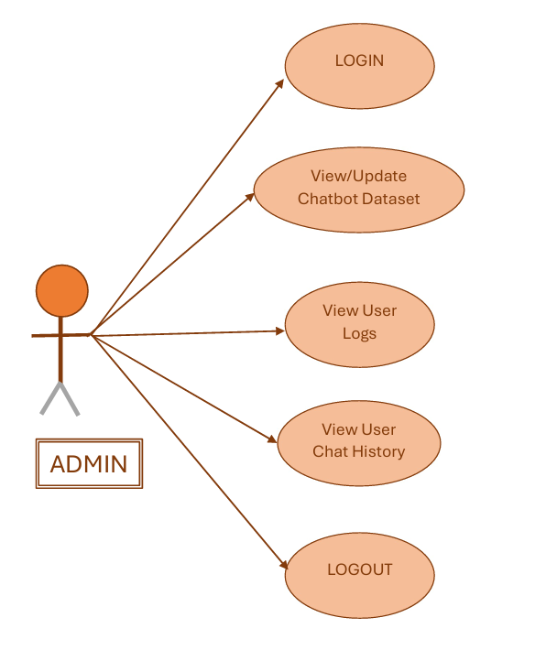
Use Case Diagram
(Admin)

Slide 12
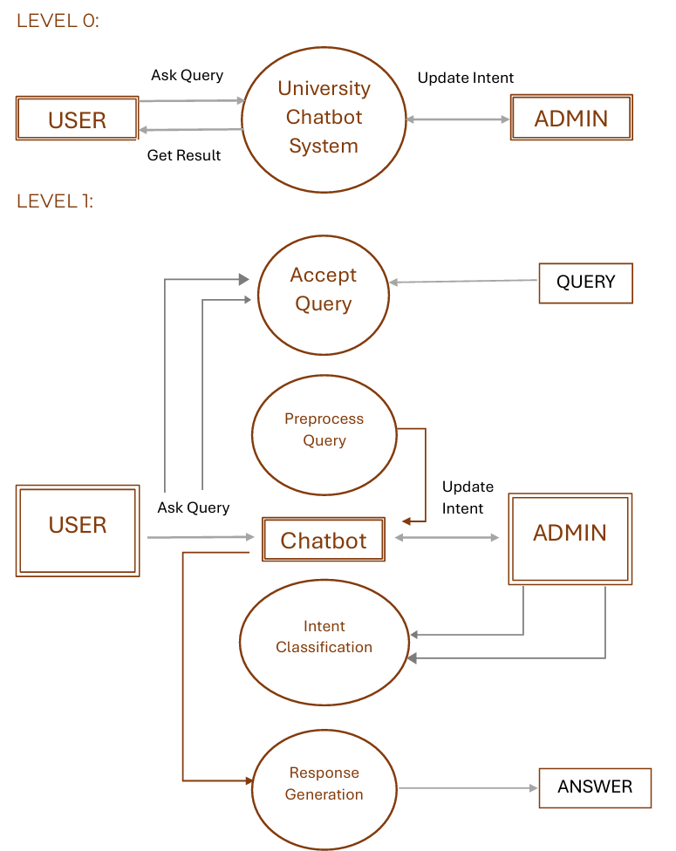
Data Flow Diagram(DFD)

Slide 13
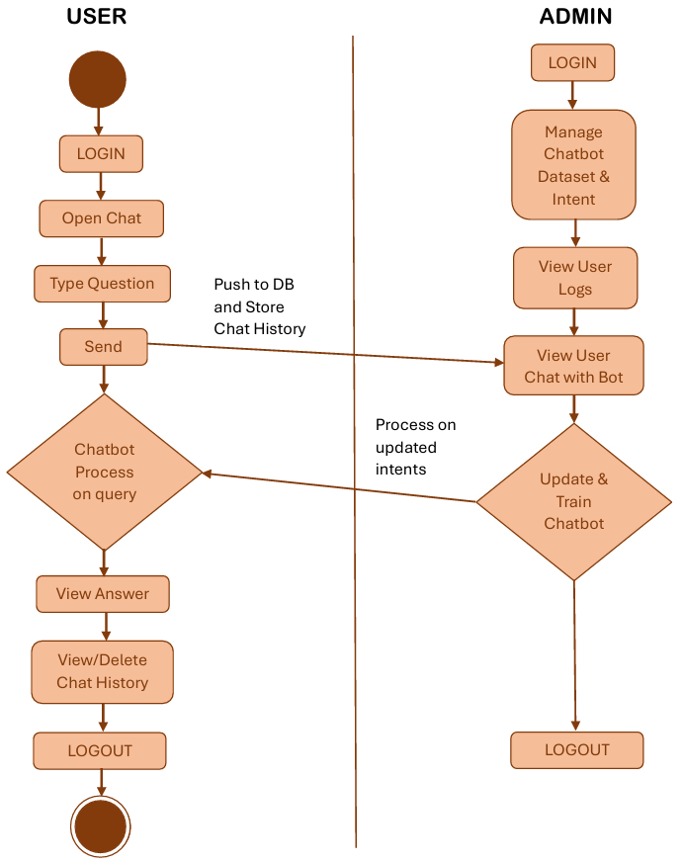
Activity Diagram

Slide 14
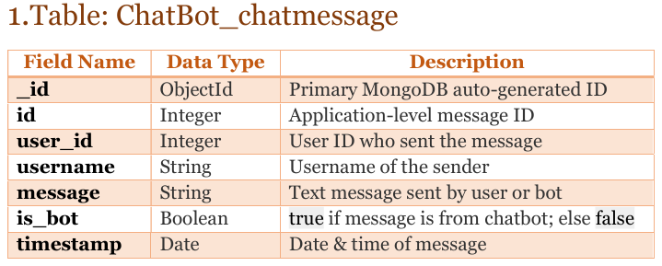
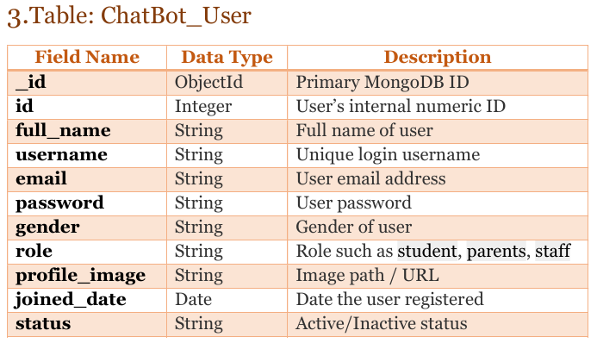
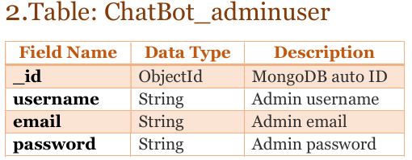
Database Schema

Slide 15
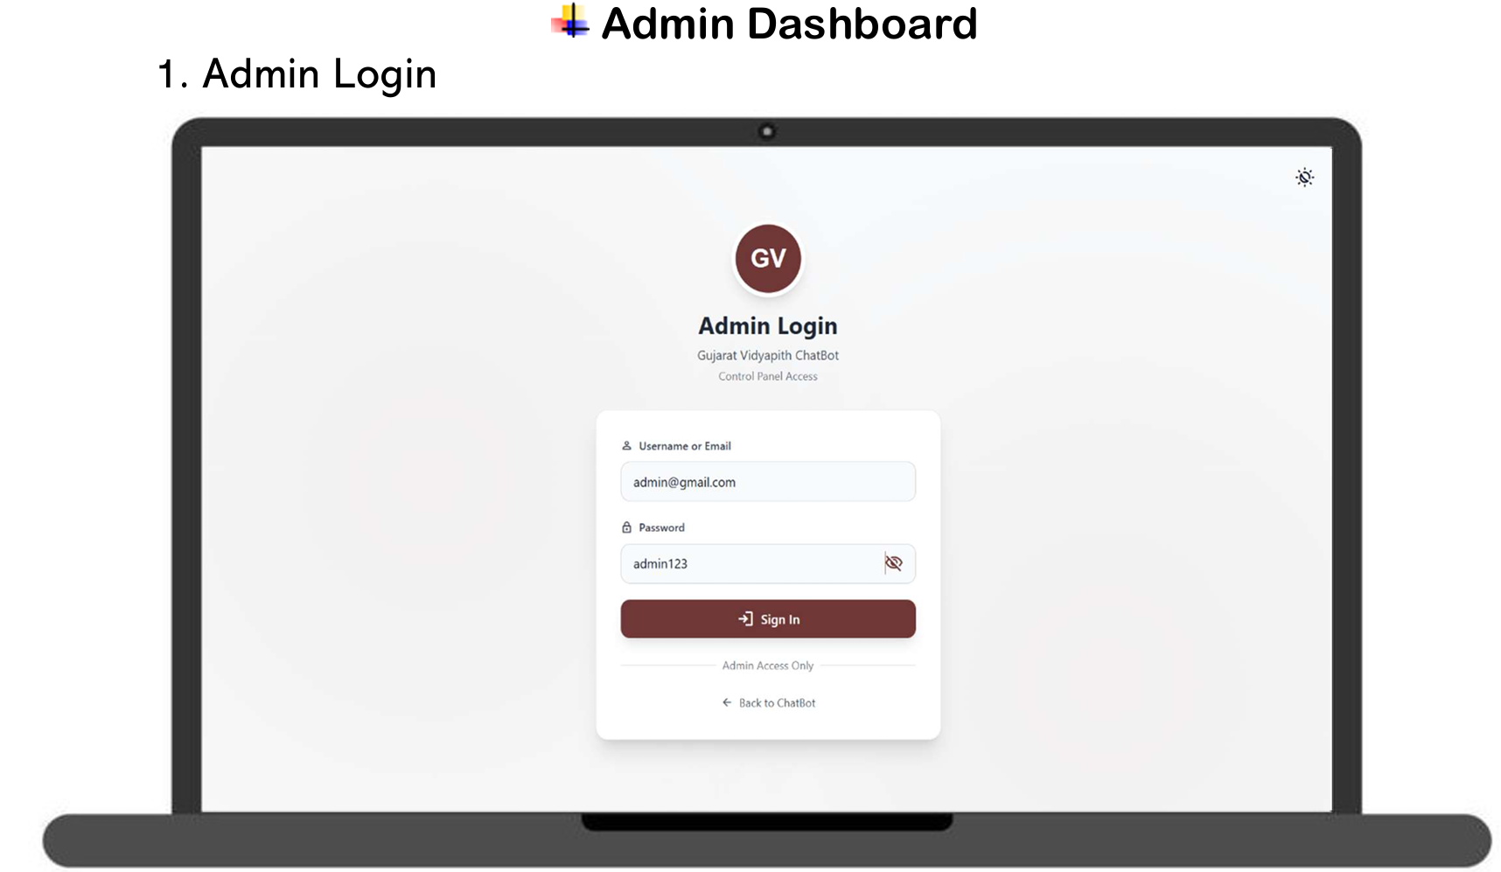

Slide 16
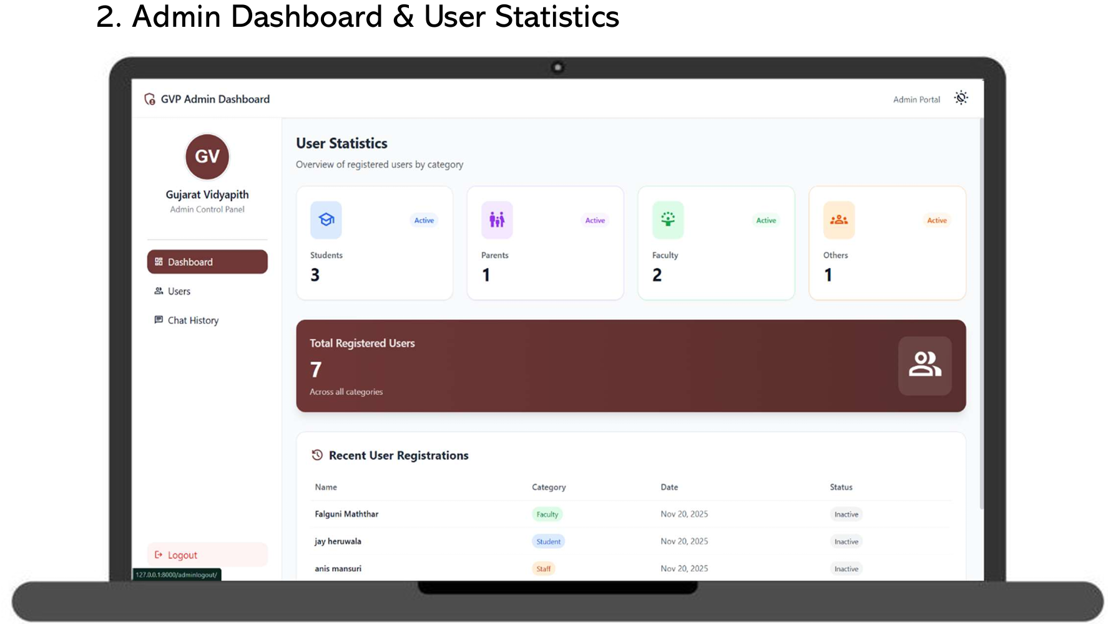

Slide 17
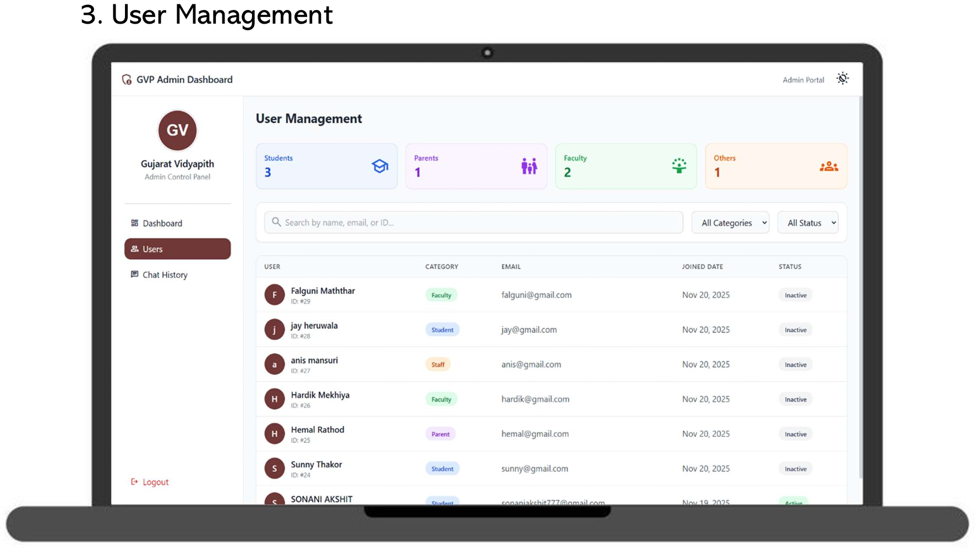

Slide 18
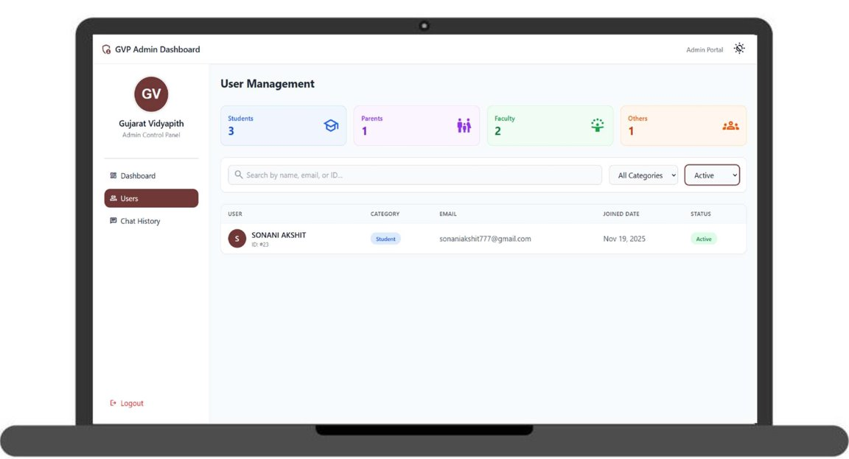

Slide 19
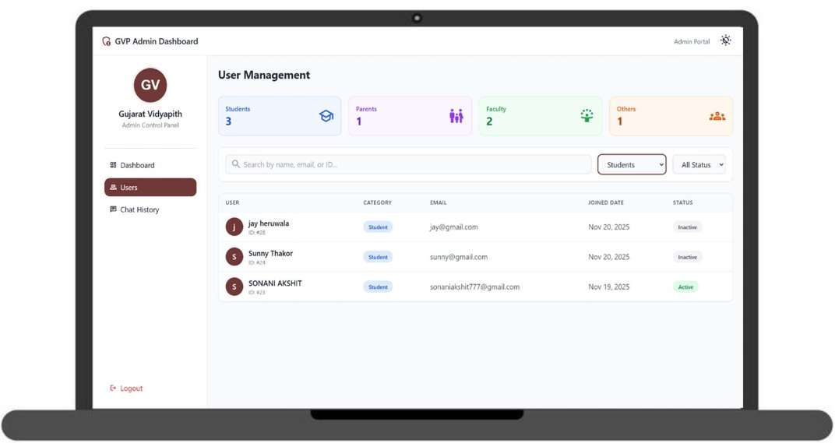

Slide 20
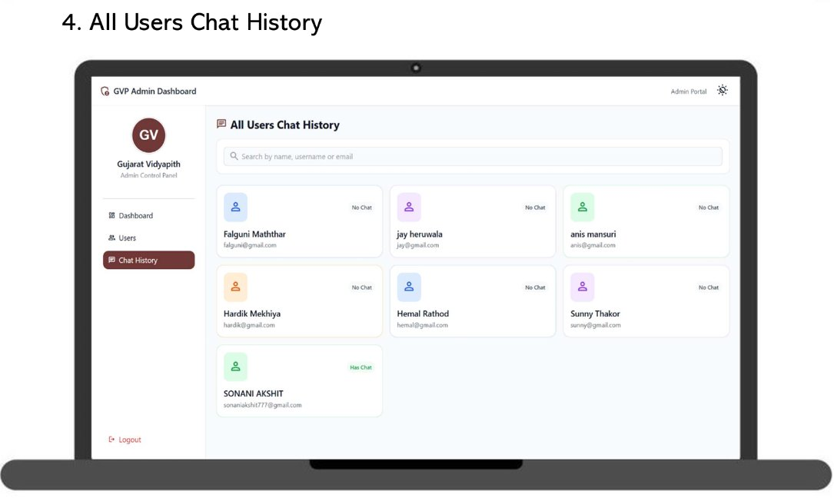

Slide 21
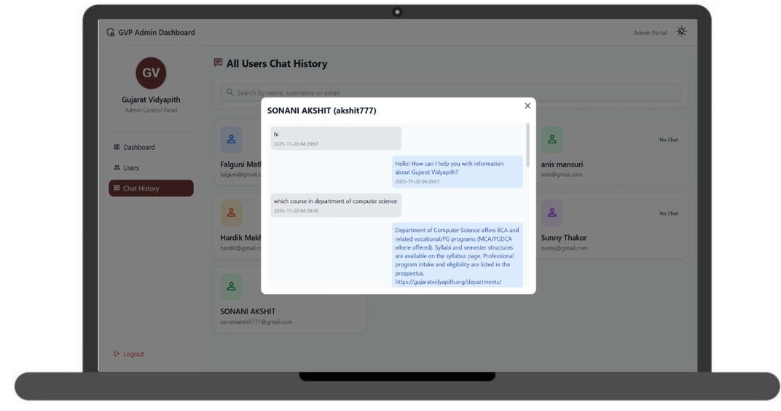

Slide 22
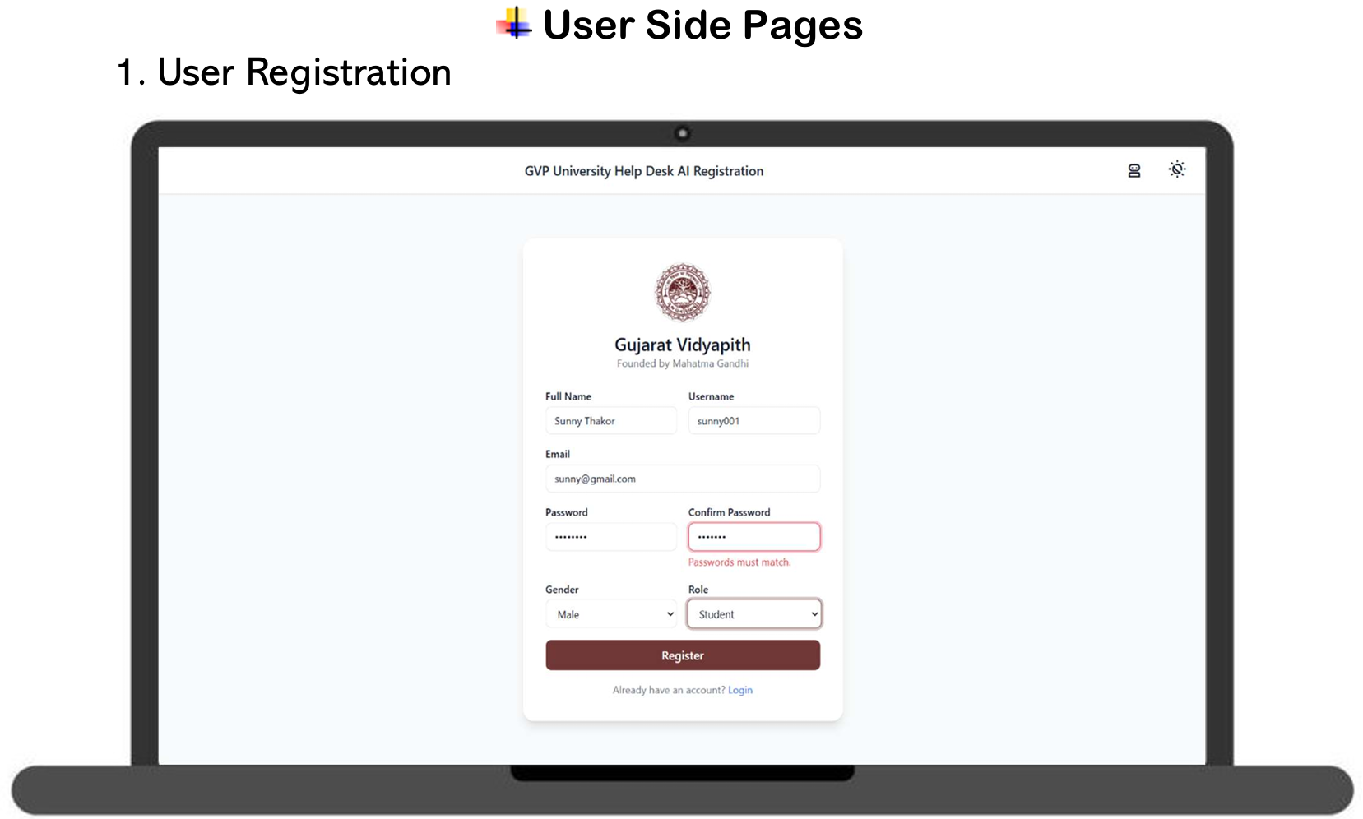

Slide 23
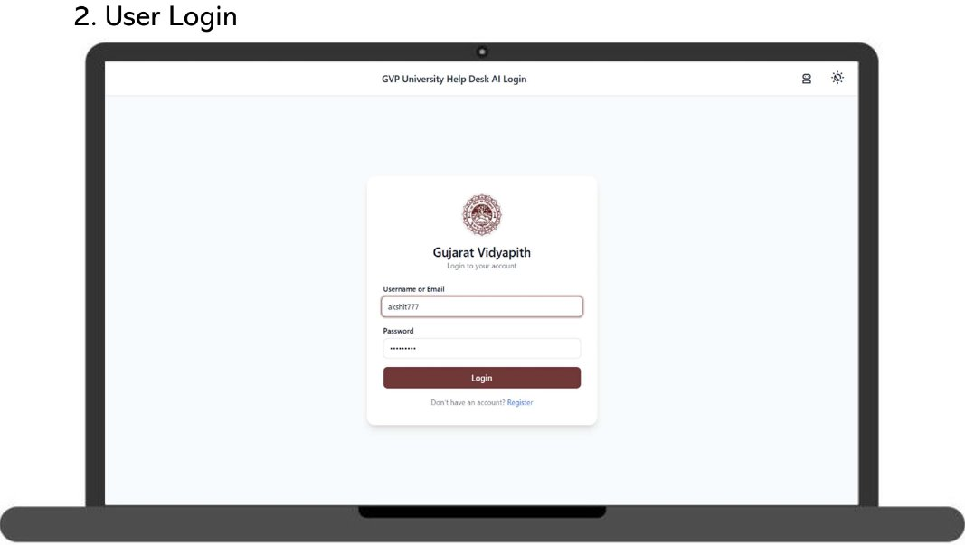

Slide 24
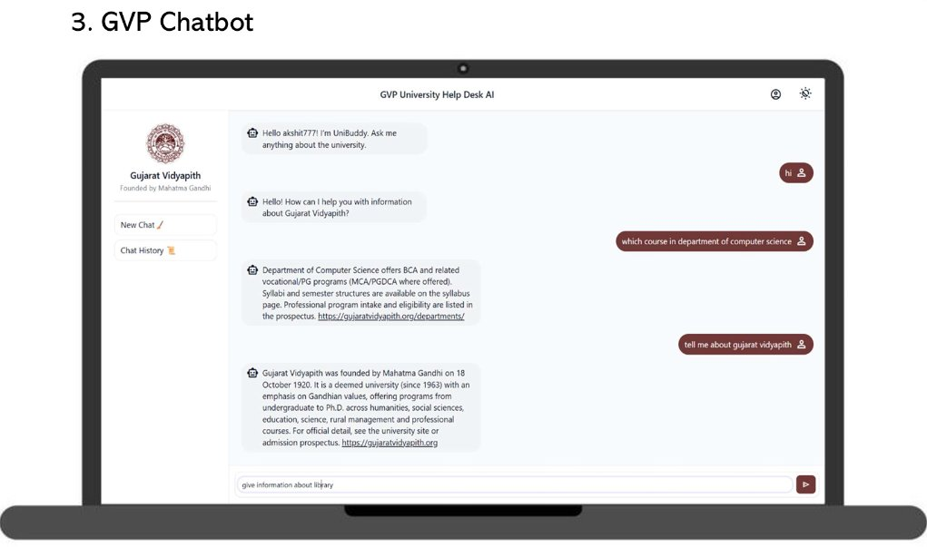

Slide 25
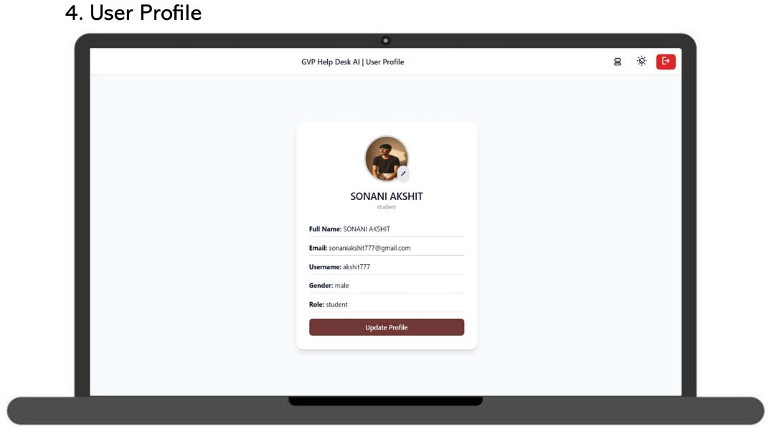

Slide 26
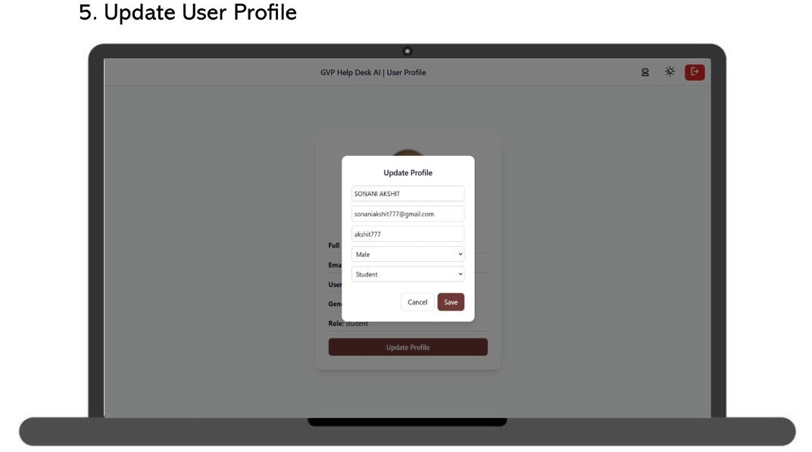

Slide 27
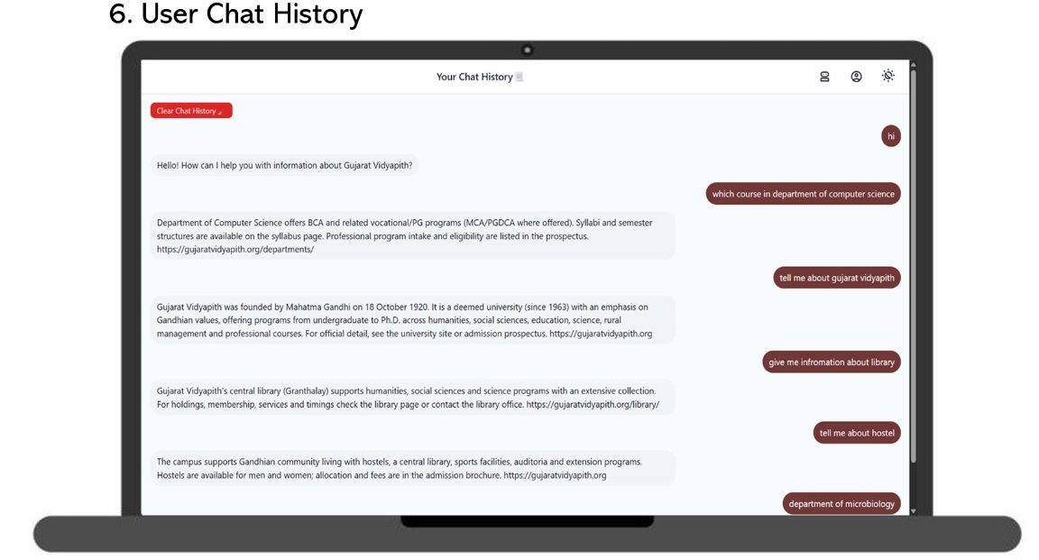

Slide 28
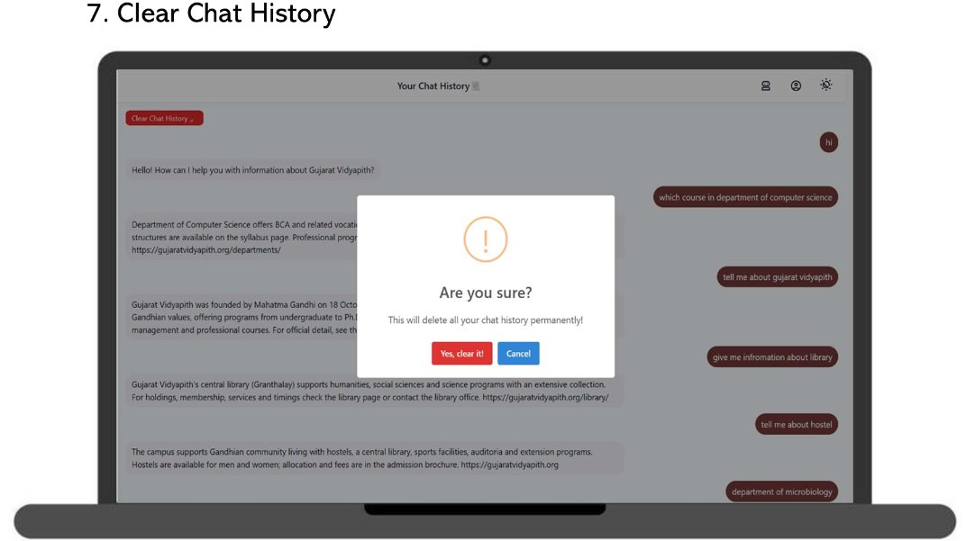

Slide 29
Thank You…

